Slide 1
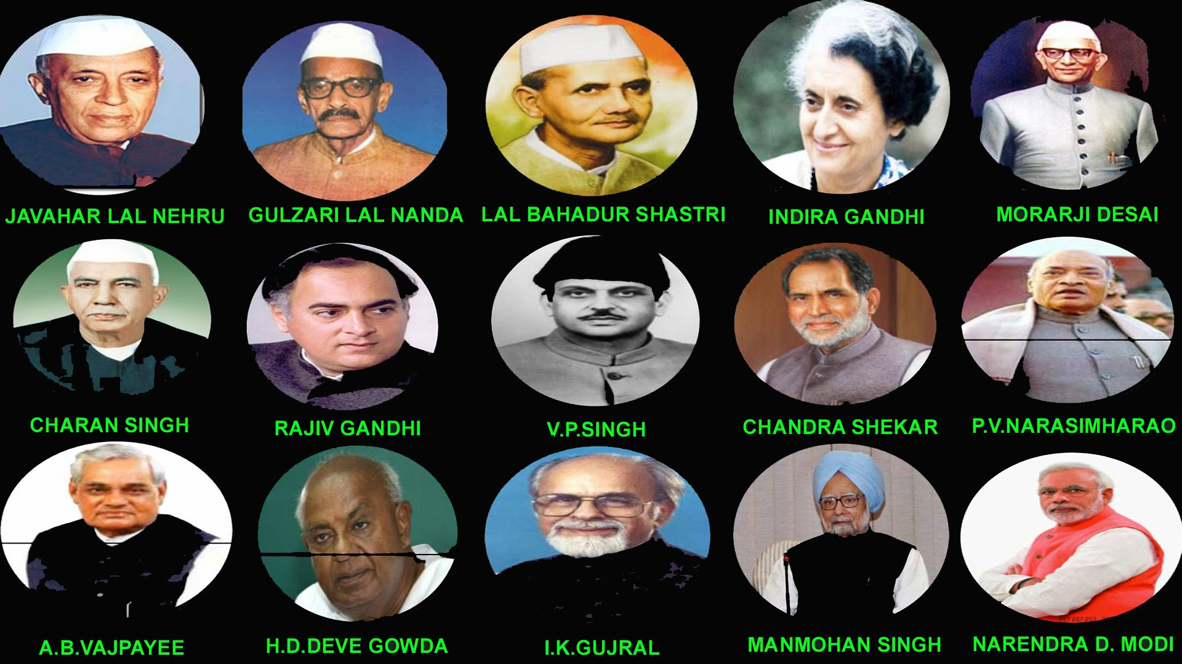
Incentives and Rewards for Scaling Up Innovations: Reflections on Food and Agriculture in India over 70 Years of Independence
Jawaharlal Nehru
Aug 15, 1947 – May 27, 1964
Gulzarilal Nanda
May 27-June 9, 1964 and January 11, 1966 –January 24, 1966
Lal Bahadur Shastri
June 9, 1964 –January 11, 1966
Indira Gandhi
January 24, 1966 –March 24, 1977 and January 14, 1980 –October 31, 1984
Morarji Desai
March 24, 1977 –July 28, 1979
Dr. M.S. Swaminathan Award Event
Charan Singh
July 28, 1979 –January 14, 1980
Rajiv Gandhi
October 31, 1984 –December 2, 1989
V.P. Singh
December 2, 1989 –November 10, 1990
Chandra Shekhar
November 10, 1990- June 21, 1991
P. V. Narasimha Rao
June 21, 1991 –May 16, 1996
October 30 2017
Atal Bihari Vajpayee
May 16, 1996 –June 1, 1996 and March 19, 1998- May 22, 2004
H. D. Deve Gowda
June 1, 1996 –April 21, 1997
I.K. Gujral
April 21, 1997 –March 19, 1998
Manmohan Singh
May 22, 2004 – May 26, 2014
(with assistance from Sambuddha Goswami)
Narendra Modi
May 26, 2014
Source: KBK infographics

Slide 2
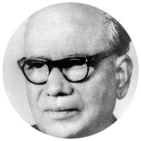
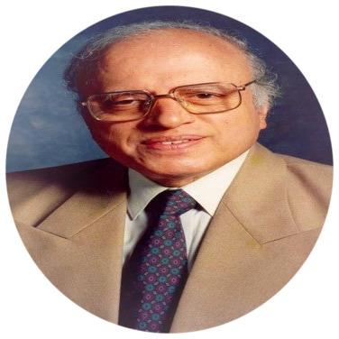
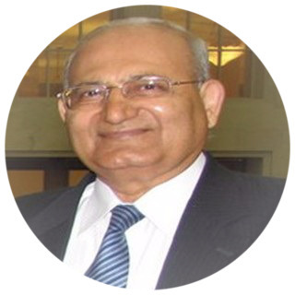
Tribute: Honor, Pleasure and Thanks
Dr. B. P. Pal: Founder of Modern Indian Agriculture Science, Science of Roses, Wheat and Rice, First DG of ICAR
Dr. M. S. Swaminathan: Spearheaded India’s Green Revolution and First Winner of World Food Prize
Dr. R. S. Paroda:
His remarkable lifetime leadership of Indian agricultural sciences

Slide 3
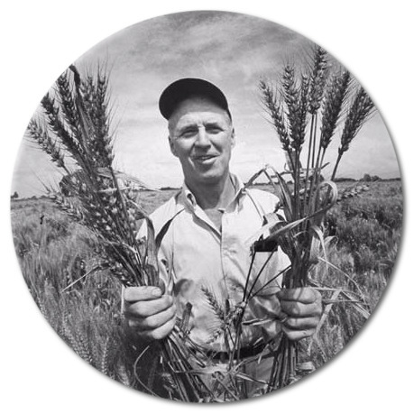
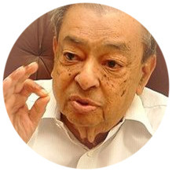
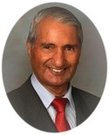
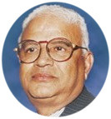
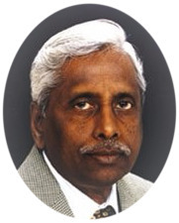
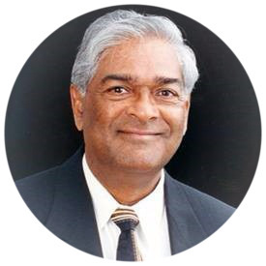
World Food Prize Winning Indians
7 out of 46 Awardees
1998 | B.R. Barwale
1989 | Dr. Verghese Kurien
1996 | Dr. Gurdev S. Khush
2005 | Dr. Modadugu Gupta
Norman Borlaug
2000 | Dr. Surinder K. Vasal
2014 | Dr. Sanjaya Rajaram

Slide 4
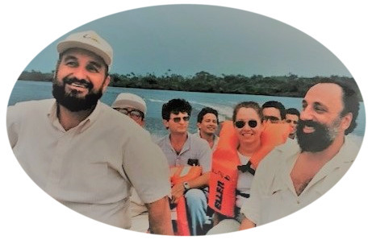
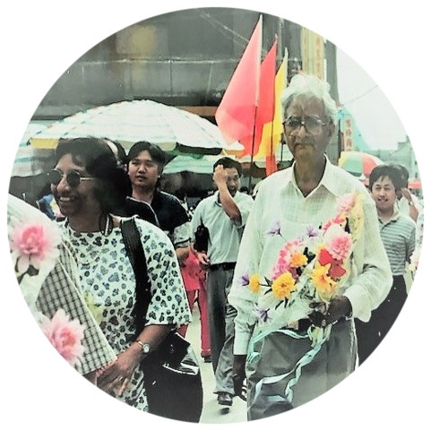
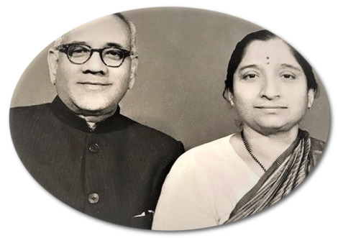
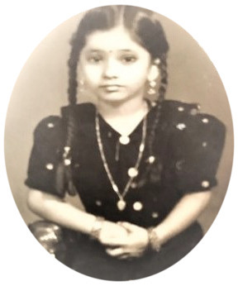
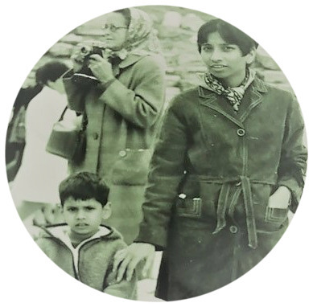
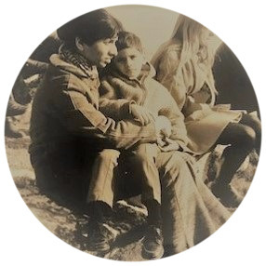
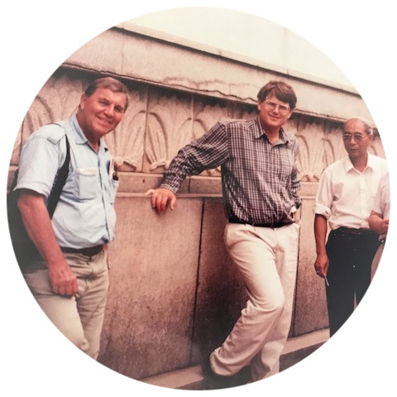
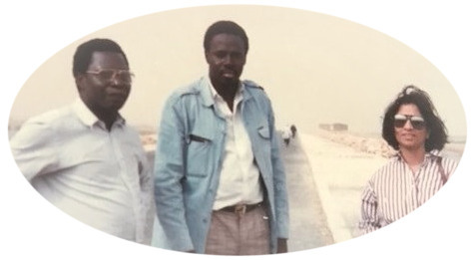
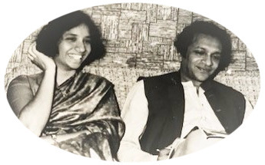
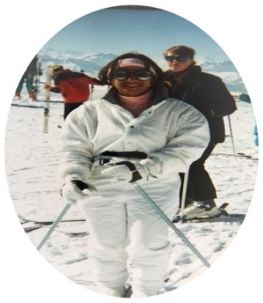
My life has spanned post-independence India

Slide 5
First Some Good News on India Besides the Obvious: We are the largest thriving democracy where leadership and systems operate differently than in Authoritarian Systems. But systems matter.

Slide 6
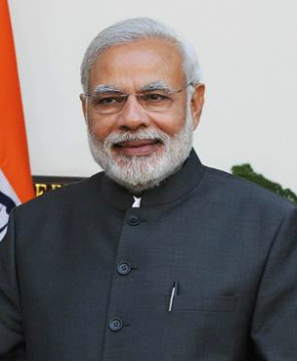
Prime Minister Has Put His Weight behind the Need to
Double Farmer Incomes
(during a ‘Kisan Rally’ in Bareilly, U.P. on Feb 28, 2016)
Debate:
Is It Achievable or would it be a “Miracle of All Miracles”? Ashok Gulhati

Slide 7
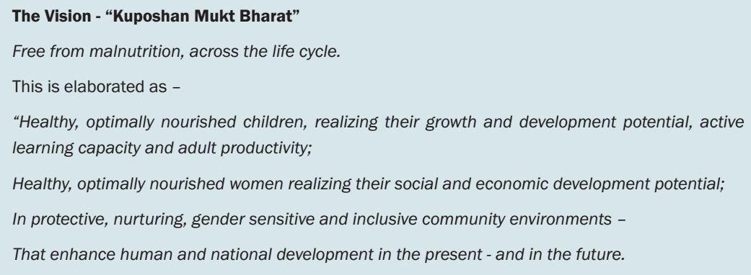
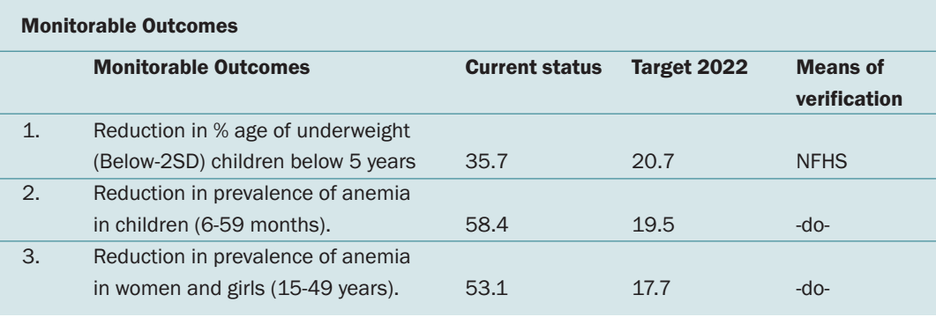
India Has A Newly Minted Nutrition Mission and Strategy
Vision 2022
GUIDING PRINCIPLES
1. A LIFE CYCLE APPROACH
2. EARLY PREVENTIVE ACTION
3. INCLUSIVE AND GENDER SENSITIVE
4. COMMUNITY EMPOWERMENT AND OWNERSHIP
5. VALUING, RECOGNIZING AND ENHANCING THE CONTRIBUTION OF ANGANWADI WORKERS.
6. DECENTRALIZATION AND FLEXIBILITY
7. OWNERSHIP OF PANCHAYATI RAJ INSTITUTIONS AND URBAN LOCAL BODIES
8. FOSTER INNOVATION
9. INFORMED BY SCIENCE AND EVIDENCE
10. ENSURE THAT THERE IS NO CONFLICT OF INTEREST
Source: Government of India (2017). National Nutrition Strategy. NITI Aayog
Notes:
Currently Slow decline in complementary foods from 52.7 percent to 42.7 percent between 2006 and 2016;
Only 9.6 percent of children between 6 and 23 months old who receive an adequate diet is only 9.6 percent for the country;
currently only 48.4 percent (Menon et al. 2017).

Slide 8
The 4th Industrial Revolution Is Already Upon Us! Its Gigantic Scale, Speed, Scope, and Complexity Offer New Opportunities and Challenges
Fourth Industrial Revolution: Time of extraordinary change in every individual, business, industry and government being impacted by breakthroughs in computing power, connectivity, artificial intelligence (AI), biotechnology and other innovative technologies, robotics, the Internet of Things, autonomous vehicles, 3-D printing, nanotechnology, materials science, energy storage, and quantum computing
A fusion of technologies blurring the lines between the physical, digital, and biological spheres.
4th Revolution has no boundaries and high velocity.
How Different from First Three Revolutions India has not yet completed?
First Industrial Revolution: water and steam power to mechanize production.
Second Industrial Revolution: used electric power to create mass production.
Third Industrial Revolution: electronics and information technology to automate production

Slide 9
Less Progress On?
India has made impressive progress in
GOI's Digital India Policy
A Nationally Cascading Public Ecosystem
JAM—Jan Dhan (the Prime Minister’s initiative to open universal bank accounts), Aadhaar, and Mobile phones
LPG Subsidy
Direct Transfers on MGNREG Scheme
From Food in kind to cash transfers?
Land Registration
Role of Minimum Support Prices (MSPs)
Attempts to Reform Agricultural Produce Market Committee (APMC) Act
E-Nam (National Agriculture Market) Scheme
99 Irrigation Projects by 2019

Slide 10
My Argument: Time for an Overarching Food and Agricultural Strategy: Need for Integrating Piecmeal Initiatives Into More Investment & Institutional Reforms to Support GOI’s Welcome Embrace of the 4th Industrial Revolution
From
Complex web of policies constraining sustained and equitable growth,
Limited role of markets and value chains,
Slow Rate of diversification,
Increased scarcity, reduced quality and intensified competition for water, soil and forests.
Ambiguous Policies to New Crop Technologies
To
A Total Governance Approach to Transform Agriculture—
i.e., Government, private sector, civil society, media, legislature and judiciary, Technology providers
Focus on:
Productivity,
Equity and
Sustainability—Climate, water, soils

Slide 11
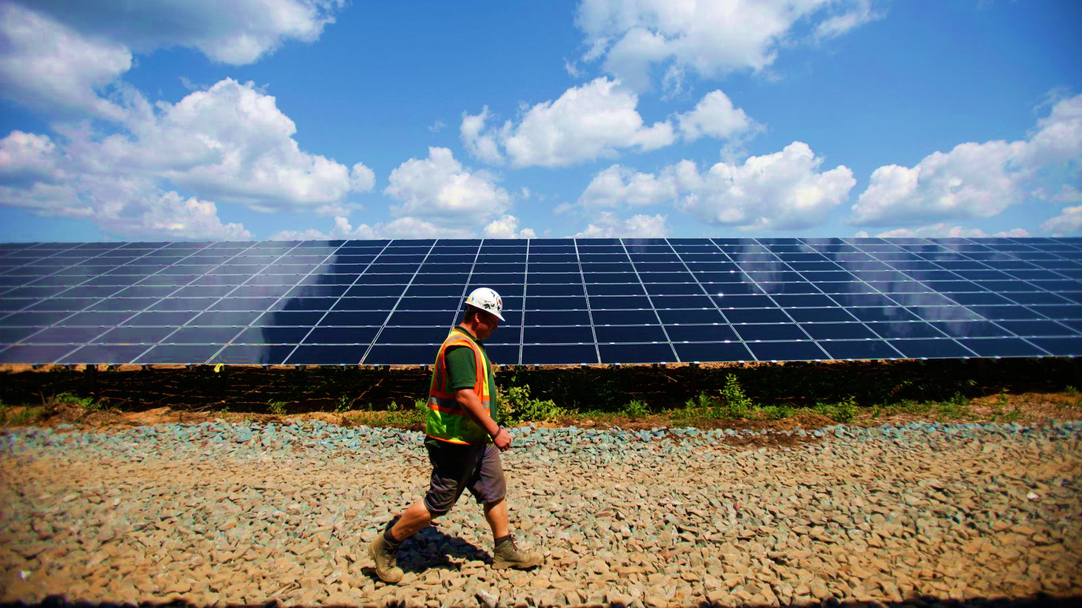
Why Growing Focus on System of Innovation? And What is Innovation?
Need for Sustained Well Functioning
Multi-stakeholder Partnerships
“ Innovation is a Process whereby individuals or organizations bring existing or new products, processes and forms of organization into social and economic use to increase effectiveness, competitiveness, resilience to shocks or environmental sustainability, thereby contributing to achieve food and nutrition security, economic development and sustainable natural resource management” (FAO, 2012).
How well is India moving from a statist to a facilitative growth process?

Slide 12
What do we (economists) typically Understand by Incentives and Rewards to Innovation?
Incentives
Rewards
Ease of doing business
Clear and Transparent Rules
Ease of Access to Information, Land, Input and Produce Markets,
Finance
Efficient Institutions free of corruption and waste
Risk Reduction Instruments
Policy Reforms which reduce obstacles to innovation
Wider choices to producers, entrepreneurs and consumers
Higher returns to farmers and entrepreneurs
More Sustainable Use of Resources
More Inclusive Growth
Less Conflict Over Resources
More resilience
Higher Overall Growth
More Rapid Structural Transformation

Slide 13
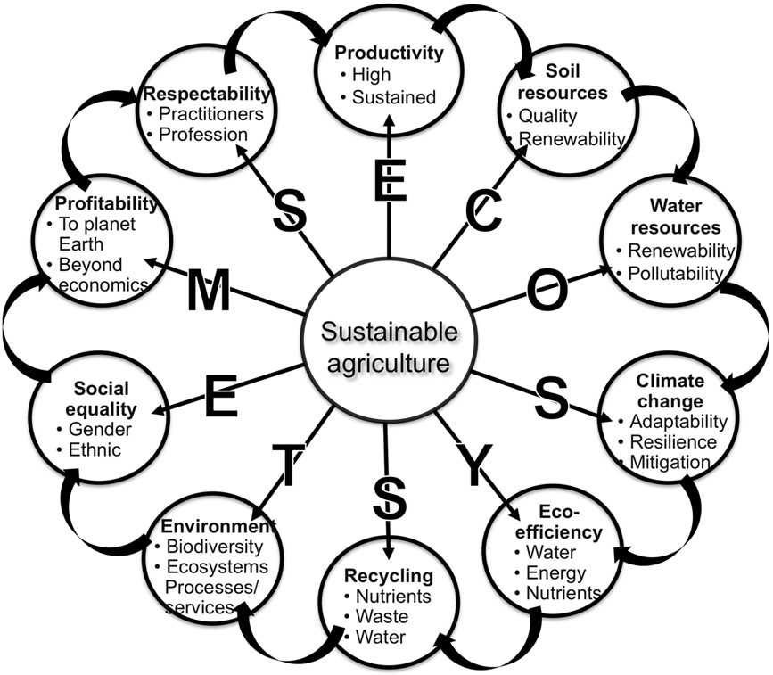
But Conservationists See Sustainable Agriculture As a
Complex System: Rattan Lal’s Ten Tenets!
C
Lal, R. (2013). Food security in a changing climate. Ecohydrology & Hydrobiology 13:8–21.

Slide 14
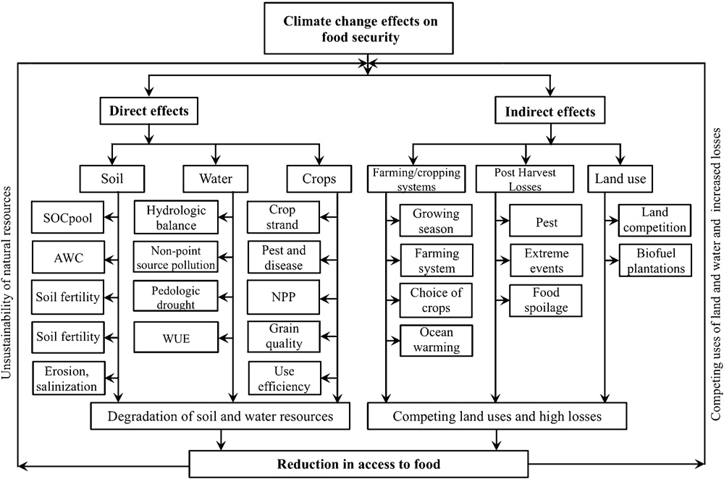
Direct and Indirect Effects of Climate Change on Food Security
Lal, R. (2013). Food security in a changing climate. Ecohydrology & Hydrobiology 13:8–21.

Slide 15
Structural Transformation Has Been Harder to Achieve in India Than Among Asian Tigers
Declined share of agriculture in GDP-- YES—now at 12%
Declining share of agriculture in employment-- NOT Yet > 50% population in ag
Rural-urban migration—Leading to Accelerated Agricultural Mechanization, Feminization of Agriculture,
Slow Growth of manufacturing sector
7 million jobs created , 12 million needed annually!
Demographic transition needed-reduced population growth rates
Slow Growth in Human Capital --Now Slower than in East Asia
Concern about “Premature De-industrialization” (Rodrik 2015, World Bank 2017)
(Source: Kuznets 1955 & 1966; Chenery and Syrquin 1975; & Timmer 2009)

Slide 16
Sustainability Challenges: Waning Role of Traditional Breadbaskets in Western India and Underexploited potential In Eastern India?
Facing diminishing returns—at the cost of mining resources
Other parts of India with huge potential—face weak public investments, institutions, infrastructure and capacity and governance issues
Co-existence of food surpluses with widespread undernourishment, rising food prices and wasteful cereal stocks
Growing demand for diversified diets, but production has not kept pace with need to diversify agriculture
MSPs have kept agriculture from diversifying

Slide 17
Indian Agricultural Transformation Comparatively with Its Neighbors

Slide 18
China and India Started with Similar Initial Conditions
India’s Bad Crop Years 2003-2009
India’s Policy Reform 1991
China’s Reform 1979
China’s Institutional Reform 1999-2003
Source: Based on FAOSTAT data
Notes:
The National Planning Commission was changed to the National Development and Planning Commission (NDPC) in 1998. In 2003, NDPC combined with Institutional Reform Office of the State Council and The National Economy and Trade Commission, and has become the current one: the National Development and Reform Commission (NDRC). I have not read any paper on this. I presume that the major shifts have been moving from planning to reform.

Slide 19
Source: Based on FAOSTAT data

Slide 20
Source: Based on data available at https://www.ers.usda.gov/data-products/international-agricultural-productivity/

Slide 21
Source: Rada, N. (2016). "India's Post-Green-Revolution Agricultural Performance: What is Driving Growth?" Agricultural Economics (47) 3: 341-350.

Slide 22
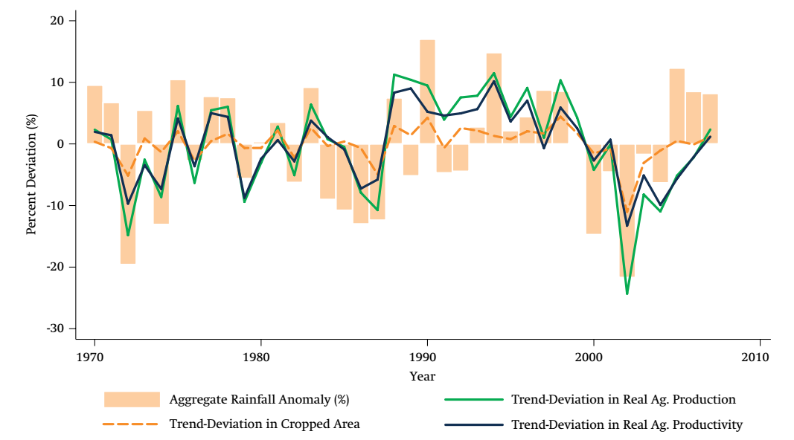
Indian Agriculture Is Still Highly dependent on Rainfall
India: Strong Correlation between Agricultural Productivity and Rainfall
Rainfall a major source of volatility
Irrigation helped in productivity growth but now challenges in large and medium scale irrigation schemes
India an outlier in groundwater exploitation
Focus of this presentation on long term strategic priorities and contemporary concerns about water constraints, employment, food prices
Source: Kshirsagar and Gautam 2013.

Slide 23
PM’s Har Khet Ko Pani Must be viewed from Sustainability/Water Governance Perspective:
During 1991-2007, India invested well over ` 200,000 crore (at 2007 prices) in irrigation and ﬂood control (Balakrishnan et al. 2008).
Yet, area served by government canals decreased by 3.8 million hectares (mha).
Massive Expansion of irrigation schemes accompanied by Scams and Corruption, Free Electricity,

Slide 24
Have Water Policy Innovations Since 2003 Improved Groundwater Control?:
Since 2003 separation of rural electricity feeders into
24 hour village supplies, and
(b) rationed, 8-hour per day, three-phase supplies to tube well users.
Drip and Sprinkler Irrigation leading to Jevon’s Effect?

Slide 25
India Ranks Last in Area Under Conservation Agriculture
in Top Ten Countries
Source: Based on FAO AquaStat: www.fao/ag/ca/6c.html

Slide 26
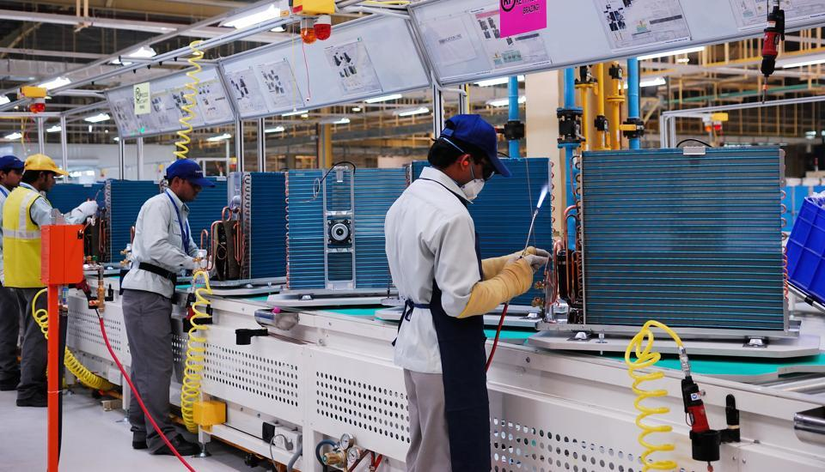
Slow Growth of Manufacturing
Growth of manufacturing
Eleventh Plan 7.7 percent—
targeted growth rate of 10 to–11 percent
In coming 15 years,
250 million join the labour force
at least, 100 million decent jobs needed.
Manufacturing sector needs to grow by 12–14 percent according to National Manufacturing Policy (GOI 2011).
Manufacturing share of GDP to 25 percent by 2030?
From current 16 percent.

Slide 27
Why Slow Agricultural Productivity Growth and Transformation?

Slide 28
Agricultural Research Expenditure as Share of
Agricultural GDP (%) (2000−2014)
+Expenditures to Promote Innovation—Increased Market Access,
More Advanced Farmers Organizations,
State and Private enterprises
Source: Based on data from https://www.asti.cgiar.org/. Note: China’s data available until 2013.

Slide 29
Source: FAOSTAT

Slide 30
Note: Data for China is not available for the year 2016; Source: FAOSTAT

Slide 31
Less Deployment of Scientific Human Capital in Agriculture

Slide 32
Source: https://www.asti.cgiar.org/data, and International Food Policy Research Institute. 2016. 2016 Global Food Policy Report. Washington, DC: International Food Policy Research Institute.

Slide 33
Differences in Human and Institutional Intensity: India and China
Source: Babu, Suresh Chandra; Huang, Jikun; Venkatesh, P.; and Zhang, Yumei. 2015. A comparative analysis of agricultural research and extension reforms in China and India. China Agricultural Economic Review 7(4); and Pal, S. (2017). Agricultural R&D Policy in India: The Funding, Institutions and Impact, ICAR–National Institute of Agricultural Economics and Policy Research

Slide 34
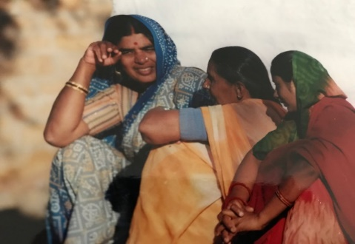
Unequal Status of Women

Slide 35
“India Still Facing A Hunger Challenge”—
IFPRI GHI 2017 Ranking
Much Debated within India
(100th position out of 119 countries in 2017)
But Facts Remain!
39 percent of children, (one third of globally) stunted
15 percent of children wasted
40 percent of women underweight
48 percent of women anemic

Slide 36
Source: WDI, World Bank

Slide 37
What to do About Nutrition? Implementation at the State level and Below the Challenge
Increase Coverage of Integrated Child Development Services and the National Health Mission)
Expand complementary foods for young children
Increase Household access to improved sanitation

Slide 38
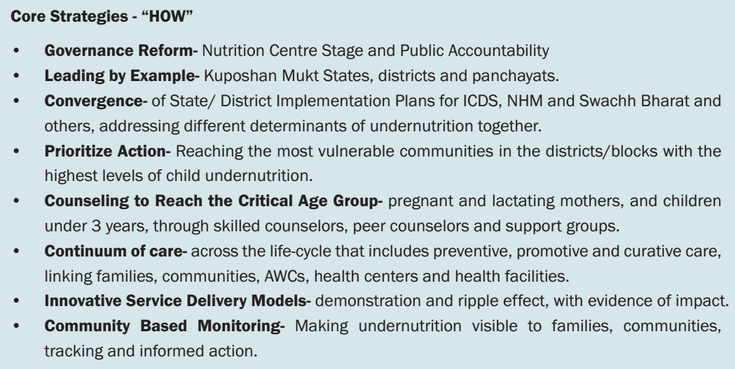
GOI’s Nutrition Strategy- HOW?: The Nutrition Strategy Framework envisages
a ‘Kuposhan Mukt Bharat’ - linked to ‘Swachh Bharat’ and ‘Swasth Bharat’

Slide 39
What Policy Reforms Going Forward?
Critics (Gulati & Hussain)
Niti Aayog Three Year Action Agenda 2017-18 to 2019-20
Increase productivity of land and water,
Deliver compensation to farmers in time,
Reform agri-markets on the lines of e-NAM—Center and States ,
Reforming tenancy laws,
Relief measures during natural disasters
Double Investments???
Get markets right,
Promote Agricultural Exports,
Direct Benefit Transfer (DBT) of Better Targeted food and fertilizer subsidies?
New Pradhan Mantri Fasal Bima Yojana (PMFBY)
Free up Land lease markets,
Invest in water to fulfil the slogan of “har khet ko pani” and “more crop per drop”???

Slide 40
Where will resources come from?
Input subsidy (irrigation, fertilizer, power and credit) increased at 6.53 percent per annum. 8 percent per annum on each head has taken place between 2000 and 2013.
Public expenditure on agriculture and irrigation grew at 4 percent annum, while that on the share of agriculture, irrigation and flood control fell substantially in total expenditure on economic services.
Source: Bathla, Seema; Thorat, Sukhadeo; Joshi, Pramod Kumar; and Yu, Bingxin. 2017. Where to invest to accelerate agricultural growth and poverty reduction. Economic and Political Weekly 52(39): 36-45.

Slide 41
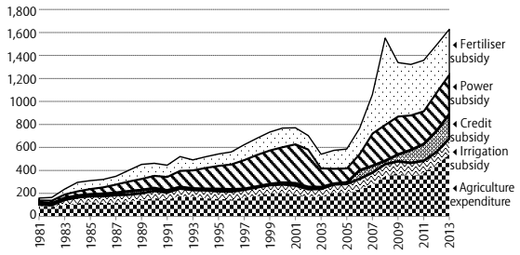
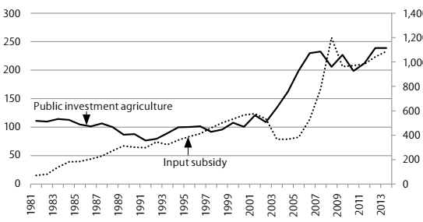
Agricultural Expenditure and Input Subsidies
(Rs billion)
Public Investment and Input Subsidies in Agriculture (Rs billion)
Source: Bathla, Seema; Thorat, Sukhadeo; Joshi, Pramod Kumar; and Yu, Bingxin. 2017. Where to invest to accelerate agricultural growth and poverty reduction. Economic and Political Weekly 52(39): 36-45.

Slide 42
Roles of Center and States in a Decentralized Democracy Focus on Bottom Up Implementation, Capacity, Monitoring, Evaluation and Learning
The myriad fragmented policy initiatives need to be replaced by a comprehensive, integrated, climate-smart strategy at the central level and in each of the states.
The current approach should be followed by a transformational process of agricultural policymaking and implementation, building ownership among all key stakeholders—from the scientific community, private sector, civil society and farming communities, and taking advantage of India’s powerful IT industry—who must play their part.
The central and state strategies need a clear, state-specific set of priorities, strong focus on implementation, and routine monitoring and dissemination of broadly agreed upon performance indicators and their determinants.
Adaptive learning within and across states, with accountability for results, should become the hallmark of development culture, replacing rigid, top-down targets.

Slide 43
THANK YOU

