Slide 1
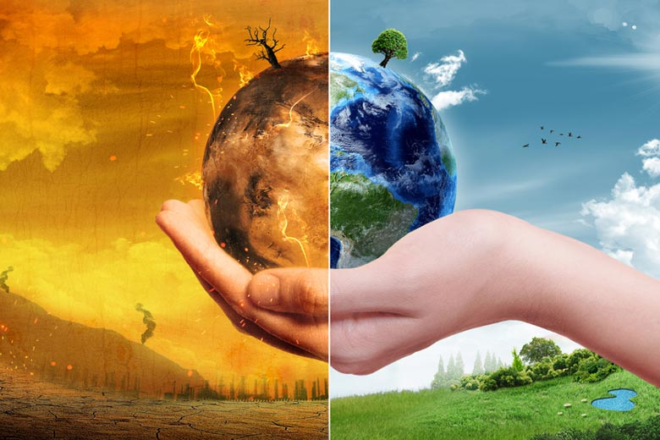
Climate Change and Doubling Farmers’ Income Experience Around the World
Uma Lele, Independent Researcher
(With Assistance from Sambuddha Goswami)
XIII Agricultural Science Congress, UAS Bengaluru and NAAS New Delhi
Bengaluru 21-24 February, 2017
Image credit: ParabolStudio / Shutterstock

Slide 2
Outline of Presentation
Recent GOI Policy of Doubling Farmer Incomes— “DFI”
Debate on definition and focus on income from (Cropping and Livestock) but household income depends on agriculture and non-agricultural income
Overview of findings on India’s recent agricultural performance and Implications for DFI
Climate Change a new complex multidimensional challenge
Calls for a transformational change --holistic ADAPTIVE, LEARNING approach-- to agricultural management, strategy formulation and implementation involving key stakeholders at multiple levels wrestling over a long period
Delicate balance between Centralized and Decentralized approach—a strong emphasis on collective action, common good, long term view
Different from the Traditional Top Down Public Sector dominated Approaches
Decentralized democracies have difficulty managing natural resources sustainably- China vs. India, US (California, vs. Nebraska), New technologies such as DRIP irrigation and crop insurance many be necessary but not sufficient
Learning from the experience of others India would need to devise its own Climate Smart approaches and policies.
This will call for an Independent stock taking of lessons of experience as input into policy with broad ownership of stakeholders and attention at the highest levels of GOI.
A well - infomed and accountable public.

Slide 3
Prime Minister’s Policy Proclamation to Double Farmers’ Income by 2022
(during a ‘Kisan Rally’ in Bareilly, U.P. on Feb 28, 2016):
Debate: Is It Possible or a “Miracle of All Miracles”?
Determinants of Farmer Income
Farm Income = f [Output x prices – cost of production]
  Annual Output per Farm Household determined by: (1) yields per unit of land per crop; (2) double or triple cropping per unit of land; (3) shift from low to higher value crops; and (4) income from livestock and fisheries.
  Farm Size = f [Share of population in agriculture, land distribution, land laws, customary practices, access to hire in or out more land and other factors of production].
  Prices determined either by Government Minimum Announced Procurement prices (MSPs) for scheduled crops or Market Prices for crops, livestock, and fisheries, for which there are no declared scheduled prices and market access.
  Cost of Production determined by Input Costs (including Input Subsidies).
Non-Farm Income = f [(Non-Farm Employment and wages) + (Entrepreneurial income from trade) + (Transfer Payments/Social Safety nets such as Mahatma Gandhi National Rural Employment Guarantee Act (MGNREGA) – Debt)]
Dynamics of Change—from technical change, market access, land consolidation, labor migration, non-farm income.

Slide 4
Climate Change Adds Complexity to Doubling Farmers’ Income Calls for Climate Smart Agriculture
Increased Productivity
Reduced GHG Emissions and Other Environmental Degradation
Increased Resilience through Adaptation
Notes:
Authors’ Depiction of FAO’s definition of Climate Smart Agriculture (CSA), “agriculture that sustainably increases productivity, enhances resilience (adaptation), reduces/removes GHGs (mitigation) where possible, and enhances achievement of national food security and development goals”. FAO 2010.

Slide 5
Source: Based on data from National Sample Survey Organisation (2014): Key Indicators of Situation of Agricultural Households in India, Ministry of Statistics and Programme Implementation, NSSO.

Slide 6
Agricultural Poverty Incidence Is Inversely Related to Average Annual Income per Agricultural Household (Rs)
R² = 0.42
Increasing agricultural household income will reduce poverty incidence .

Slide 7
Recent Sources of Growth in Indian Agriculture
Yields per ha have grown slowly
Intensification of agriculture has come from
  Irrigation
  Some Shift to higher value crops—output growth away from the northern “grain belt” and toward high-value agriculture in traditionally less-productive regions. E.g. geographical and intensity shifts in Central Region.
  But nationally most of the increase in farmer income has been due to price increases since 2004
  Yet farm Real Income has stagnated despite subsidies and transfer incomes
  Inter-state income differences are considerable and also incidence of poverty with no evidence of convergence?
  Difference between farm and non-farm income has increased substantially particularly since 2004
  Source: Ramesh Chand 2016, World Bank 2014, Nicholas Rada 2016

Slide 8
Source: Rada, N. (2016). "India's Post-Green-Revolution Agricultural Performance: What is Driving Growth?" Agricultural Economics (47) 3: 341-350.

Slide 9
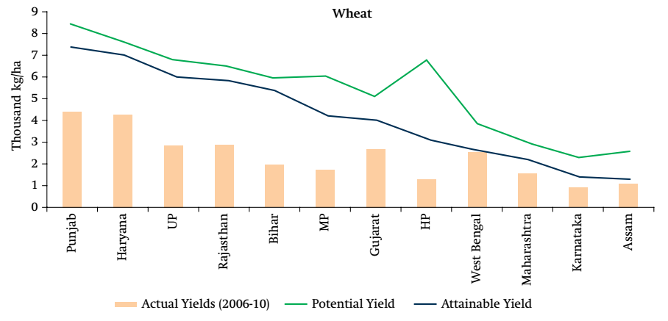
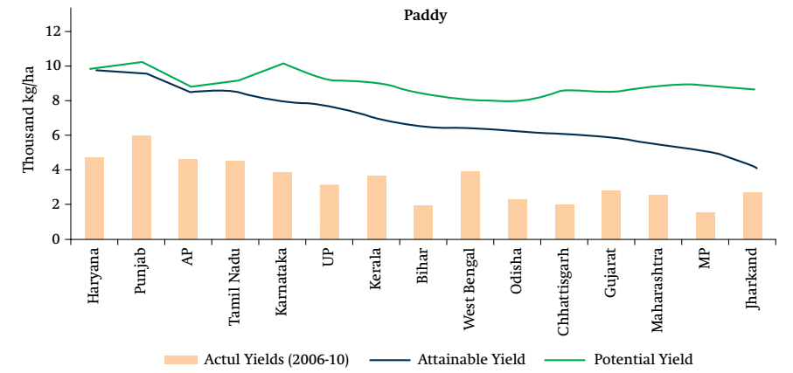
Simulated potential yields (assuming no constraints to inputs), attainable yields (given the current level of irrigation), and actual yields (average of 2006–10)]
Current Yield Gaps for Wheat by State
Current Yield Gaps for Paddy/Rice by State
Source: WBG (2014). Republic of India Accelerating Agricultural Productivity Growth.

Slide 10
Climate Change
Calls for Business “Unusual” to Reduce Impacts on Poverty
Impacts of CC on Agriculture
Impacts of Agriculture on Climate Change
Extreme Climate Variability beyond Average Attributable to Natural Causes
Rising temperatures
Increasing temperature variability
Changes in levels of precipitation
Melting of Glaciers
Rising Sea levels, salinization of fresh water
Droughts and floods/water stress
Loss of coastal areas
Areas out of farming Desertification
Increased Pastes and Diseases
Forest fires
Lower Yields, fish stocks and animals
Increased food insecurity
Environmental refugees
Annual anthropogenic GHG emissions (CO2, Methane and Nitrous Oxide)
Land Use Changes
  Deforestation and forest degradation
Agriculture
    Rice-----------Methane Production
    Livestock-----Methane Production
    Fertilizer use

Slide 11
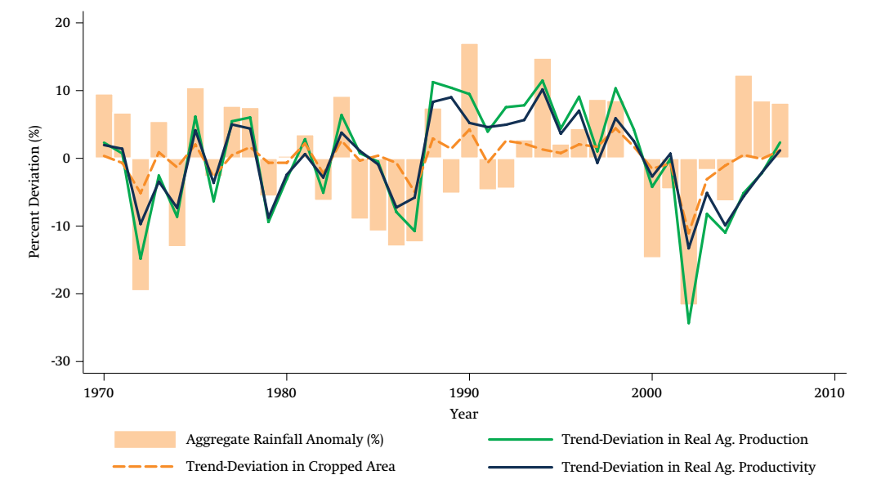
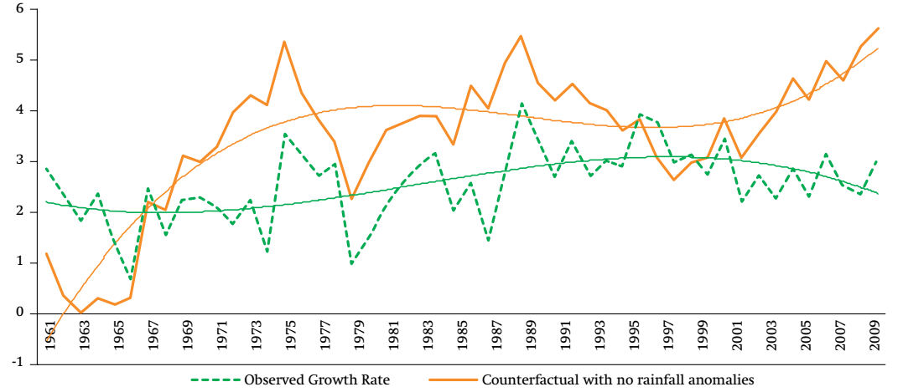
India: Strong Correlation between Agricultural Productivity and Rainfall
Ten-Year Average Agricultural GDP Growth Rates (actual and counterfactual scenarios)
Had Rainfall Been Better, Agricultural GDP Growth Would Have Been Higher!
Source: Kshirsagar and Gautam 2013.

Slide 12
Data provided by Ramesh Chand and Chand (2016): Doubling Farmer’s Income: Strategy and Prospects. Presidential Address

Slide 13
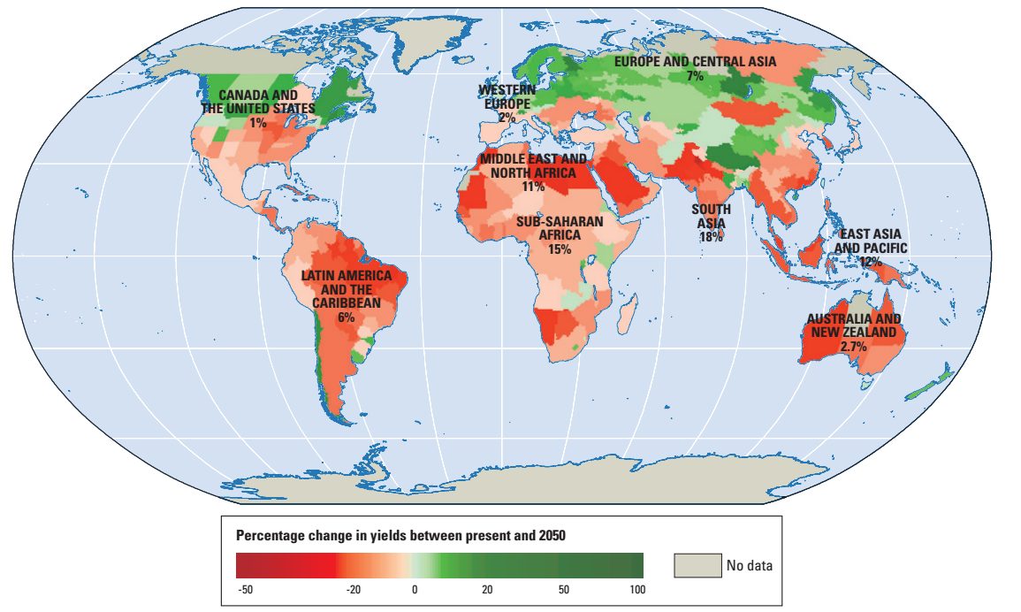
Climate Change Could Decrease Agricultural Yields in Most Countries in 2050
(given current agricultural practices and crop varieties)
Notes:
Sources: World Bank 2010; Note: The coloring in the figure shows the projected percentage change in yields of 11 major crops (wheat, rice, maize, millet, field pea, sugar beet, sweet potato, soybean, groundnut, sunflower, and rapeseed) from 2046 to 2055, compared with 1996–2005. The yield-change values are the mean of three emission scenarios across five global climate models, assuming no CO2 fertilization (a possible boost to plant growth and water-use efficiency from higher ambient CO2 concentrations). The numbers indicate the share of GDP derived from agriculture in each region. (The share for Sub-Saharan Africa is 23 percent if South Africa is excluded.) Large negative yield impacts are projected in many areas that are highly dependent on agriculture.

Slide 14
Source: CAIT Climate Data Explorer. 2015. Washington, DC: World Resources Institute. http://cait.wri.org. CAIT data are derived from several sources. Full citations are available at http://cait.wri.org/faq.html#q07. Source of Land-Use Change and Forestry and Agriculture data is FAOSTAT Emissions Database.

Slide 15
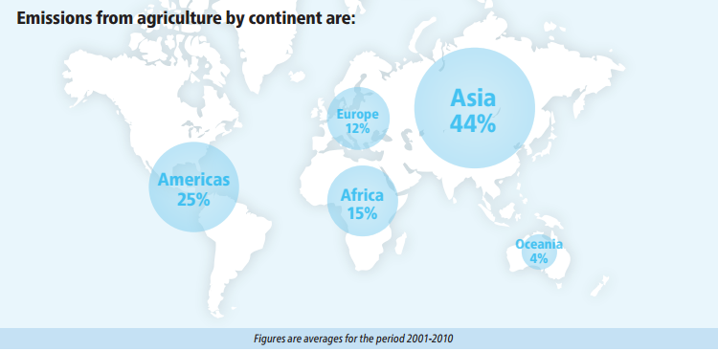
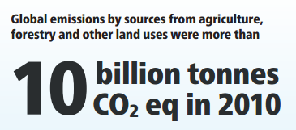
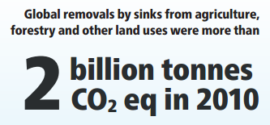

Asia Dominates in Global Emissions from Agriculture
Emissions from energy use in agriculture added another 785 million tonnes CO2 eq in 2010

Slide 16
Experience of East and South East Asian Countries
East and South-East Asia: where
Faster TFP Growth
More Rapid Reduction in Rural Poverty
Greater Intensification of Agriculture
More Increase in Farm Income
More Favorable Internal Terms of Trade
Sharper Drop in Share of Population in Agriculture
BUT Increased Rural Urban Inequalities!
Increased Stress on Resources?
Climate Change calls for a holistic transformative approach to agriculture
  Current Indian Approach--- too little and too fragmented
  India Needs Transport, power, R and D, education, security of tenure, access to agricultural finance,
Huge under-investment in agriculture and rural sector relative to countries but NO SILVER BULLETS!

Slide 17
TFP Estimates Do Not Include Environmental Costs
Resource Loss
Productivity Growth estimates do not measure growing water scarcities, soil loss, deforestation and forest degradation
China has done better on climate mitigation in agriculture (Greater area under reforestation, payments for environmental services in forestry) than other countries;
Better on water management—S and T, Investments, rewards, incentives and penalties
Indonesia and Brazil—Productivity Growth but with largest emitters from deforestation
Going Forward
More Frequent Floods and Droughts, Growing Water Shortages, including transboundary issues from local to global
Growing Water-related conflicts

Slide 18
Source: Based on FAOSTAT data

Slide 19
Source: Based on FAOSTAT data

Slide 20
Source: Based on data available at https://www.ers.usda.gov/data-products/international-agricultural-productivity/

Slide 21
Value Added per Worker

Slide 22
Country | Economically Active Population in Agriculture (million) (2013) | Economically Active Population in Non-Agriculture (million) (2013)
Bangladesh | 32 | 43
China | 494 | 339
India | 274 | 242
Indonesia | 50 | 77
Vietnam | 31 | 19
Source: Based on FAOSTAT data and WDI, World DataBank, World Bank

Slide 23
Source: Based on FAOSTAT data and WDI, World DataBank, World Bank

Slide 24
Country | Employment in Agriculture (million) (2014) | Employment in Industry (million) (2014) | Employment in Services (million) (2014)
Bangladesh | 41 | 11 | 24
China | 244 | 234 | 298
India | 209 | 123 | 139
Indonesia | 41 | 24 | 50
Vietnam | 25 | 12 | 18
Source: Based on Global Employment Trends, ILO and WDI, World DataBank, World Bank

Slide 25
Source: Based on Global Employment Trends, ILO and WDI, World DataBank, World Bank

Slide 26
Source: Based on Global Employment Trends, ILO and WDI, World DataBank, World Bank

Slide 27
Terms of Trade

Slide 28
Source: Based on WDI, World DataBank, World Bank

Slide 29
Source: Based on WDI, World DataBank, World Bank

Slide 30
Agricultural Research Expenditure as Share of Agricultural GDP (%) (2000−2014)
+Expenditures to Promote Innovation—Increased Market Access,
More Advanced Farmers Organizations,
State and Private enterprises
Source: Based on data from https://www.asti.cgiar.org/. Note: China’s data available until 2013.

Slide 31
Climate and Indian Agriculture

Slide 32
Source: CAIT Climate Data Explorer. 2015. Washington, DC: World Resources Institute.

Slide 33
India: Livestock, Rice and Nutrients Dominate GHG Emissions
Agricultural Subsector (1990 and 2014)
Source: Based on FAOSTAT Data

Slide 34
China: Livestock, Rice and Nutrients Dominate GHG Emissions
Agricultural Subsector (1990 and 2014)
Source: Based on FAOSTAT Data

Slide 35
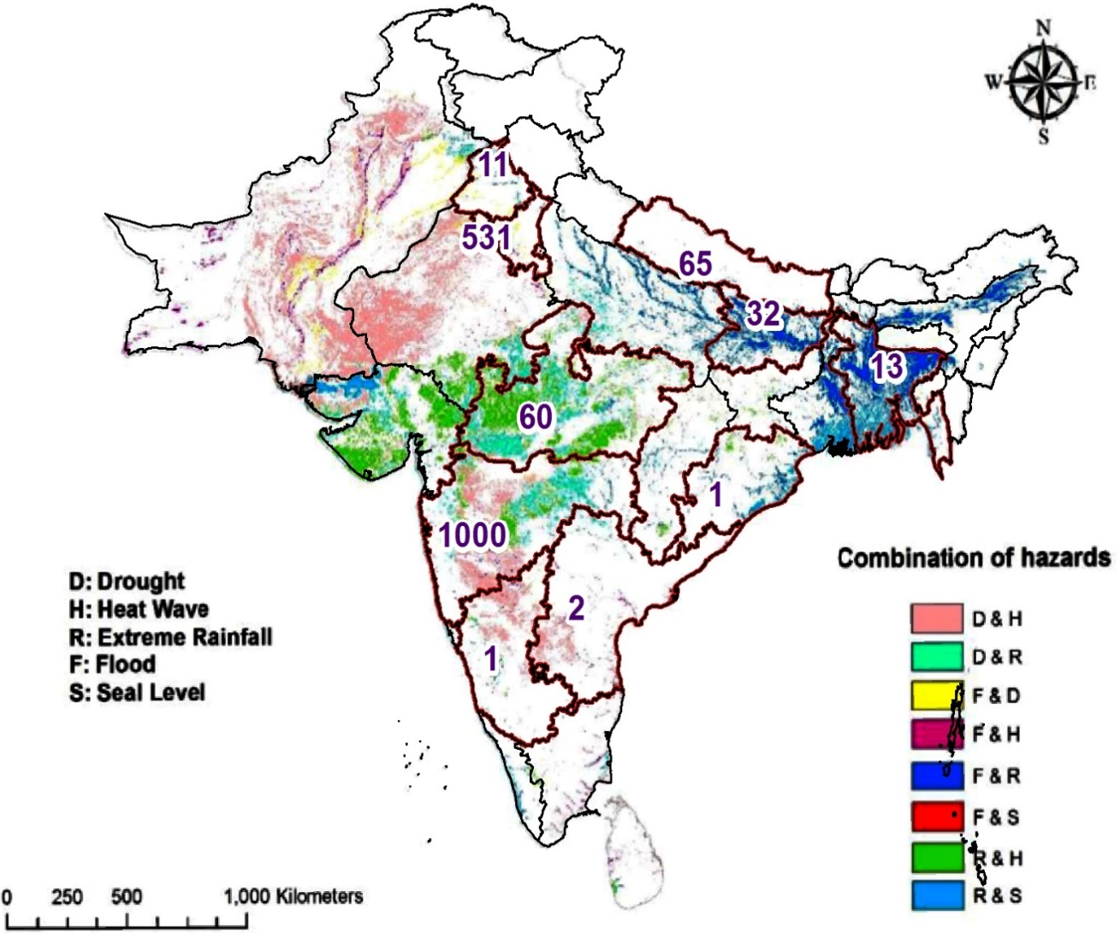
Climate Smart Villages in South Asia
End of 2016
Source: Pramod Agarwal (2016). Climate-smart agriculture: Addressing weather-risks related agrarian distress, CGIAR Research Program on Climate Change, Agriculture and Food Security, Borlaug Institute for South Asia, CIMMYT, New Delhi-110012, India

Slide 36

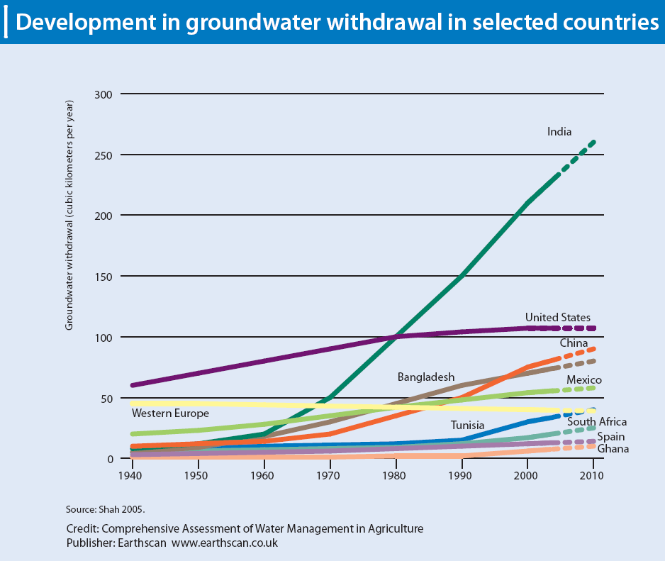
“India inherited the world’s largest canal infrastructure in 1947;
Today India is the world’s groundwater champion!”----
Tushaar Shah, Senior Advisor, IWMI
Notes:
India is particularly challenged – extensive abstraction for agriculture due to subsidized rates raises sustainability concerns and increases access costs

Slide 37
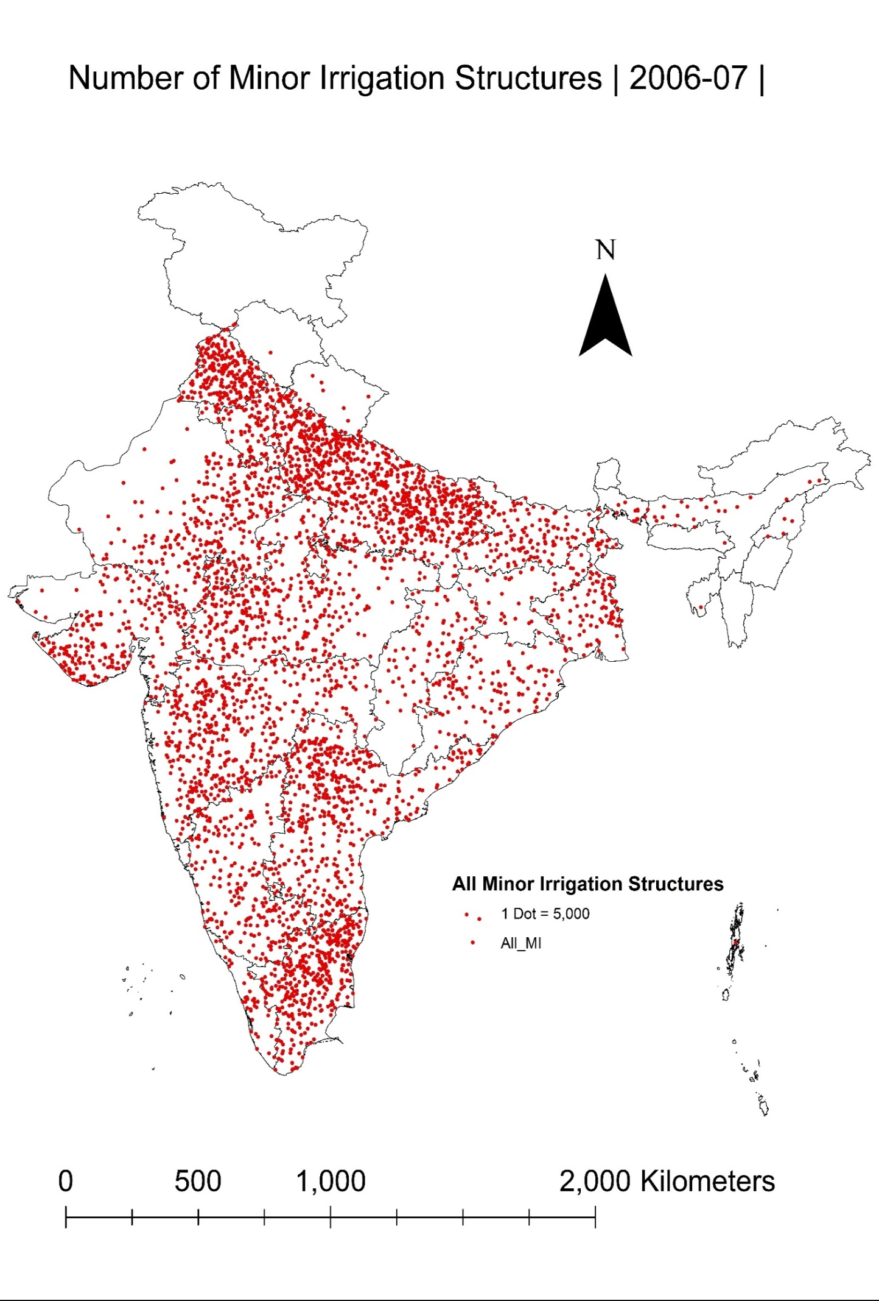
Taming India’s Groundwater Anarchy—Tushaar Shah
2006-07
Each dot equals 5000 irrigation wells.
Irrigation low, where groundwater is not developed or managed

Slide 38
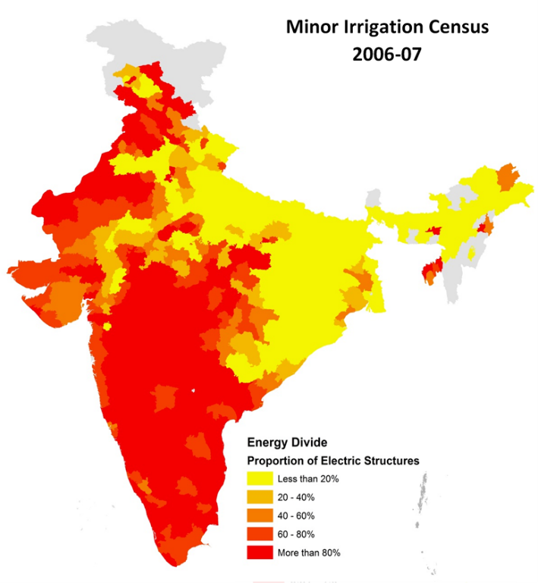
India’s Energy Divide, 2006-07
Eastern India has abundant groundwater but no energy to pump it
In western India, perverse power subsidies have ruined aquifers .

Slide 39
Lessons from Madhya Pradesh on Groundwater Management
MP utilized millions of ha of unutilized irrigation potential created in major, medium and minor irrigation projects.
Provided reliable power ration to farmers during peak irrigation season. multiplied the state's irrigated area quickly, at small incremental cost, delivering double-digit agricultural growth.
Had MP used the ﬁve successive years of normal monsoon during 2009-2013 to maximize groundwater recharge, and had eﬀective mechanisms been put in place for judicious use of this recharge, Madhya Pradesh could well have sailed through even two successive drought years.
Eﬀective demand management of water must be the next priority of irrigation reforms.
Source: Tushaar Shah et al, Har Khet Ko Pani? (Water to Every Farm?) Emulate Madhya Pradesh's Irrigation Reform, IWMI-Tata Policy Paper
Tushaar Shah Gourav Mishra Pankaj Kela
Pennan Chinnasamy

Slide 40
Total Conservation Agriculture (CA): 157 Million ha, about 11% of Global Arable Cropland
Percent of Global CA Area by Region
Source: Based on FAO AquaStat: www.fao/ag/ca/6c.html
Notes:
*CONSERVATION AGRICULTURE
Minimum Tillage,
Permanent soil crop cover, crop residue, mulch
Crop rotation and intercropping
Average adoption level in each region based on arable land area of reporting countries

Slide 41
Source: Based on FAO AquaStat: www.fao/ag/ca/6c.html

Slide 42
Some Frequently Offered Solutions to Climate Change Challenge
Switch to varieties tolerant to heat, drought and salinity
Increase irrigation efficiency
Manage soil, nutrients and erosion
Match livestock to supply of grazing land
Promote Mixed farming-crops and animals
Control Pastes and Diseases,
Restore degraded habitats,
Improve infrastructure
Promote Crop Insurance
USE Safety nets

Slide 43
Implications for Policy: No Silver Bullets! #1
Improve climate data and climate forecasting at all levels
Make data available to farmers well in advance
Tailor Advice on Farming System Management to Changing Climate
Promote climate resistant agriculture, e.g., integrated cropping and livestock- multiple resistance—resilient to weather, more pulses, fruit and vegetable, less irrigated cereals
Promote Crop Varieties with multiple resistance
Promote conservation agriculture, no till—improve soil, land and water management
Promote Landscape Management
Restore degraded lands through agro –forestry

Slide 44
Implications for Policy: No Silver Bullets! #2
Scaling Up Challenge:
Reduce Emissions from Livestock—only 1% of livestock population under rationed balance
GMOs??????
Livestock—Rationed Balanced Diet—1% of 75 million livestock population under rationed balanced approach
Conservation Agriculture—2% of India’s ag under CA compared to what percent under China?
Water Management—35 million under drip irrigation?
Water rationing?
Foster a national food and agricultural market—eliminate cross border restrictions
Increase security of land tenure
Invest in Physical Infrastructure—Roads, Renewable Energy

Slide 45
Implications for Policy: No Silver Bullets! #3
Implementation , Implementation, Implementation
Establish Inter-Ministerial/Departmental Coordinating Mechanisms
Use Monitoring and Evaluation to Improve Project Design and Implementation
Increase Focus on R and D—Strengthen ICAR, SAUs, Public-Private Partnerships
Crop Insurance cannot be a new form of subsidy!
Social Safety nets already exist and need to be streamlined
Institutionalize Disaster Relief—
Invest in Physical Infrastructure
Introduce Accountability Mechanisms to political and administrative actors
Make the most of the Indian IT industry.
Invest in Human Capital
Get citizens involved.

Slide 46
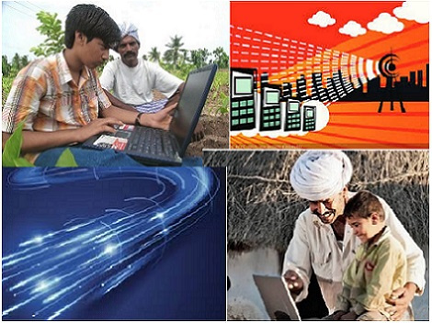

Thank You
Image credit: CXOToday.com
Image credit: Digital India | Image cedit :digit.in

