Slide 1
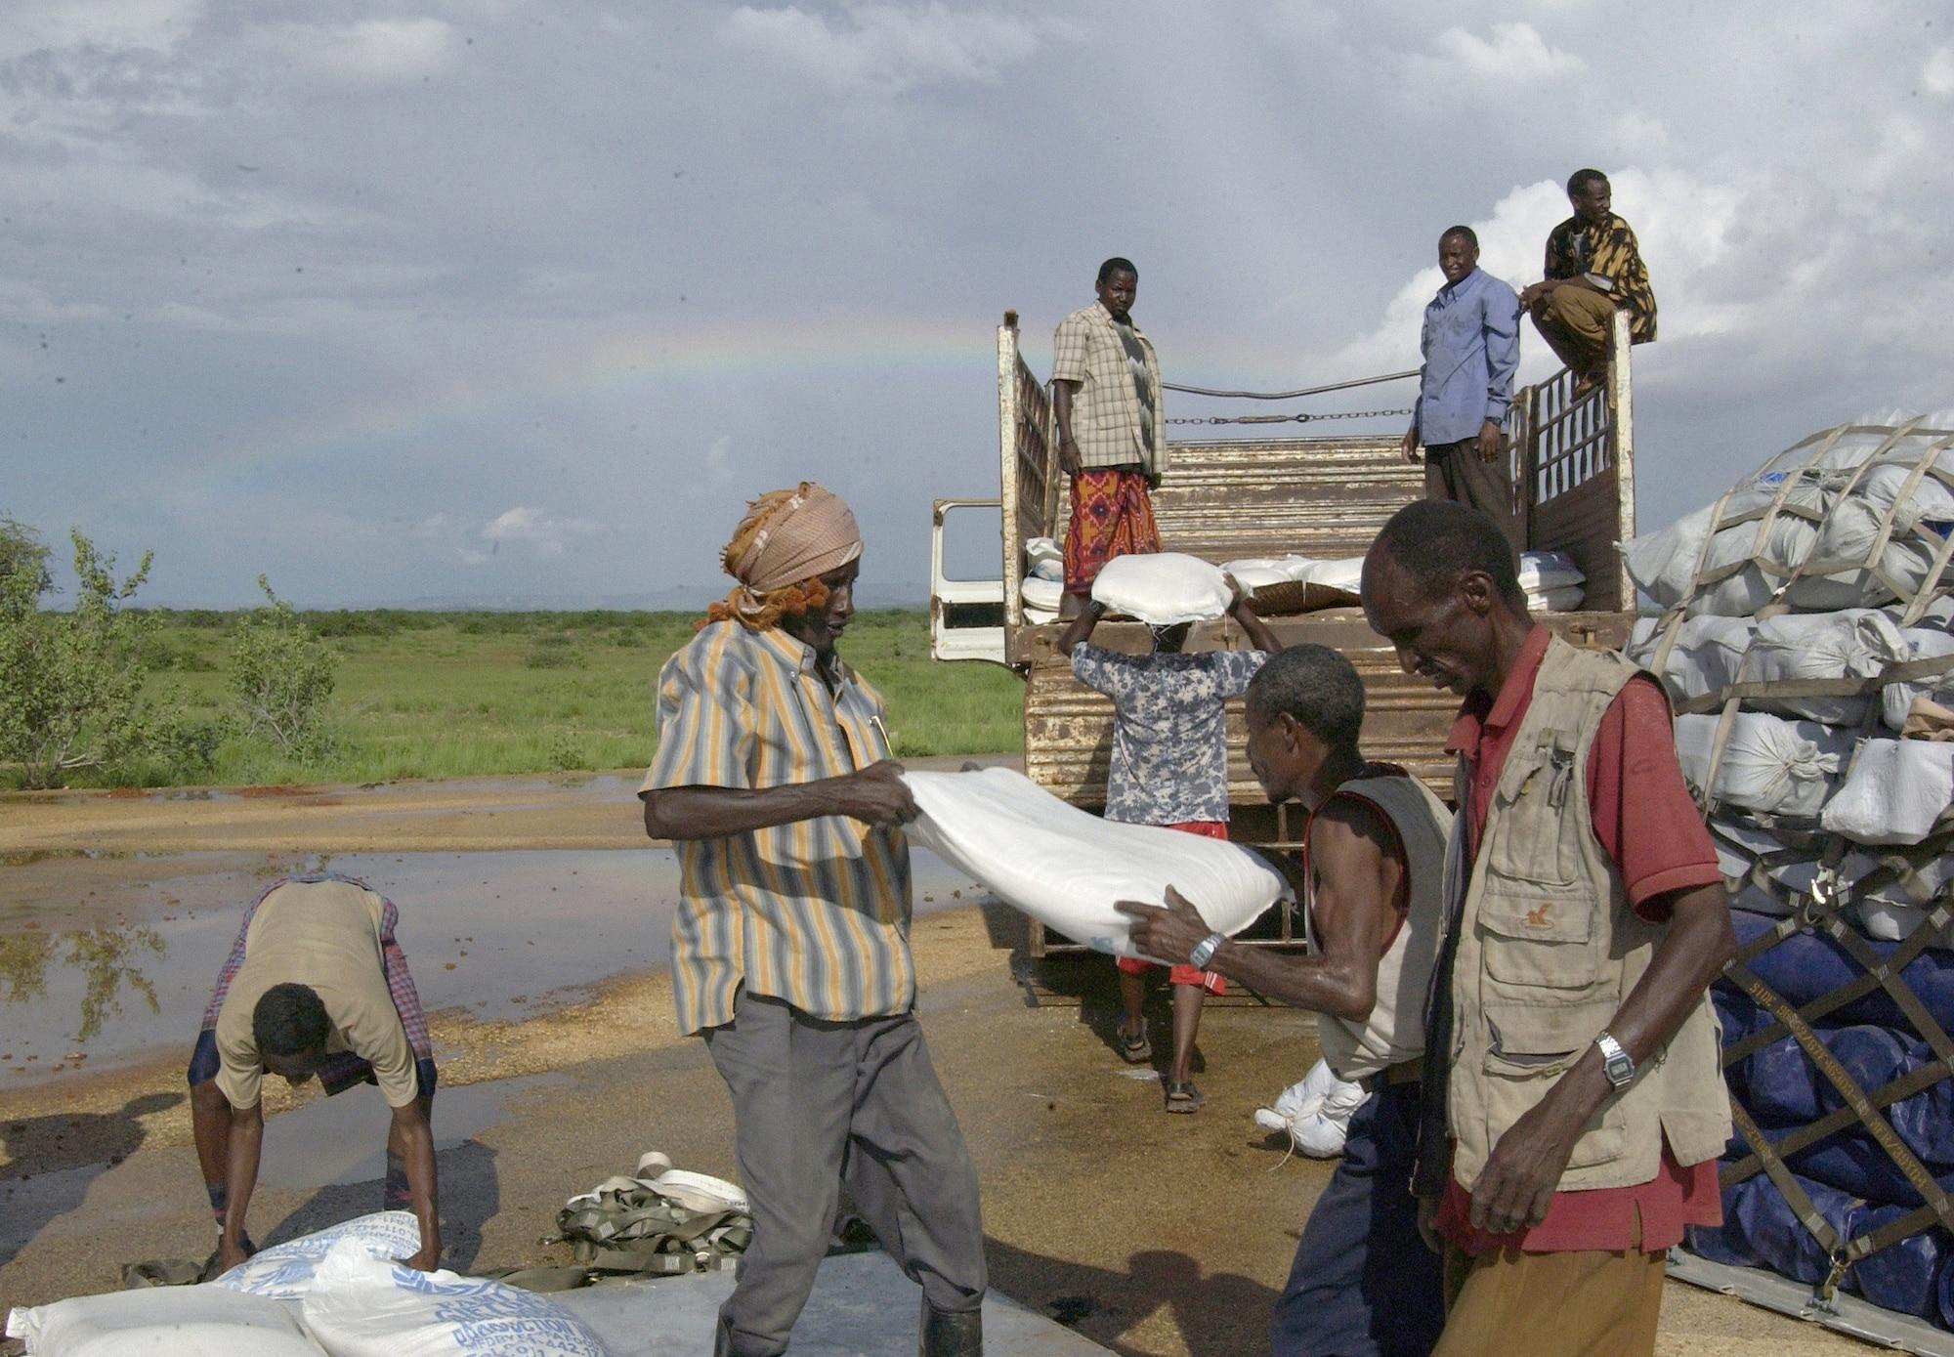
South Asia Regional Integration
Uma Lele
Sambuddha Goswami
AAEA Organized Symposium
July 24 2023
Notes:
Entered text
Motivation
The world has experienced major food crises since the 1970s—in 1973–74, 2007–8, and 2021–22. and many small ones.
In each case, sharp rises in food prices were accompanied (or preceded) by concomitant increases in fertilizer and energy prices.
The session will explore the causes and consequences of these crises--similarities and differences in the underlying causes as well as policy responses of developing countries and donors, in the context of major structural changes in the world—
Developing Countries have become massively more important in production, trade, and stocking policies, relative to developed countries.
They have also tended to follow defensive policies to protect their consumers
So what lessons does history offer
Introduction to speakers
Chris Delgado
Ghada Elabed
Will Martin
Their Brief CVs:
Chris Delgado: WRI, World Bank, IFPRI
Ghada Elabed from Ghana—education in France and the US, YP in the Bank starting 2014
Will Martin: Distinguished career at the WB and IFPRI in the area of trade and development
Plan of Action: What each will do
Chris will provide an overview covering 1970s to today—comparing similarities and differences in the nature of food crisis
Ghada will explore how support to agriculture of Pre-pandemic: $640 billion (2016-18 average by 79 countries, and Latest estimate: $817 billion (2022 estimate for 54 countries by OECD)
can be repurposed to better address problems of food insecurity, poverty, climate change, and unsustainable patterns of food production and consumption.
Will Martin—addresses the impact of developing countries’ domestic price insulation on the changing wheat international markets
Then we will open the session for questions/discussion
General Conclusions
Entered text
Motivation
The world has experienced major food crises since the 1970s—in 1973–74, 2007–8, and 2021–22. and many small ones.
In each case, sharp rises in food prices were accompanied (or preceded) by concomitant increases in fertilizer and energy prices.
The session will explore the causes and consequences of these crises--similarities and differences in the underlying causes as well as policy responses of developing countries and donors, in the context of major structural changes in the world—
Developing Countries have become massively more important in production, trade, and stocking policies, relative to developed countries.
They have also tended to follow defensive policies to protect their consumers
So what lessons does history offer
Introduction to speakers
Chris Delgado
Ghada Elabed
Will Martin
Their Brief CVs:
Chris Delgado: WRI, World Bank, IFPRI
Ghada Elabed from Ghana—education in France and the US, YP in the Bank starting 2014
Will Martin: Distinguished career at the WB and IFPRI in the area of trade and development
Plan of Action: What each will do
Chris will provide an overview covering 1970s to today—comparing similarities and differences in the nature of food crisis
Ghada will explore how support to agriculture of Pre-pandemic: $640 billion (2016-18 average by 79 countries, and Latest estimate: $817 billion (2022 estimate for 54 countries by OECD)
can be repurposed to better address problems of food insecurity, poverty, climate change, and unsustainable patterns of food production and consumption.
Will Martin—addresses the impact of developing countries’ domestic price insulation on the changing wheat international markets
Then we will open the session for questions/discussion
General Conclusions
Entered text
Chris will provide an overview covering 1970s to today—comparing similarities and differences in the nature of food crisis
Ghada will explore how support to agriculture of Pre-pandemic: $640 billion (2016-18 average by 79 countries, and Latest estimate: $817 billion (2022 estimate for 54 countries by OECD)
can be repurposed to better address problems of food insecurity, poverty, climate change, and unsustainable patterns of food production and consumption.
Will Martin—addresses the impact of developing countries’ domestic price insulation on the changing wheat international markets
Then we will open the session for questions/discussion
General Conclusions

Slide 2
Performance of South Asian Countries
Source: World Development Indicators, World Bank

Slide 3
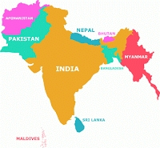
South Asia is less integrated than East and South East Asia
Intraregional trade: Intraregional trade in South Asia is low, accounting for <5% of the region's total trade. This is in comparison to East Asia, where intraregional trade accounts for 35%, and Southeast Asia, accounts for 25%.
Investment: Intraregional investment in South Asia is also low, accounting for only 0.6% of the region's total investment. This is in comparison to East Asia, where intraregional investment accounts for 25%, and Southeast Asia, where intraregional investment accounts for 15%.
Infrastructure: The infrastructure in South Asia is also less developed than in East and Southeast Asia. This makes it more difficult and expensive to transport goods and services between countries in South Asia.
Political factors: Hindered regional integration in South Asia:
Historical animosities
Security concerns
Economic factors: Hindered regional integration in South Asia:
Different economic levels
Lack of investment

Slide 4
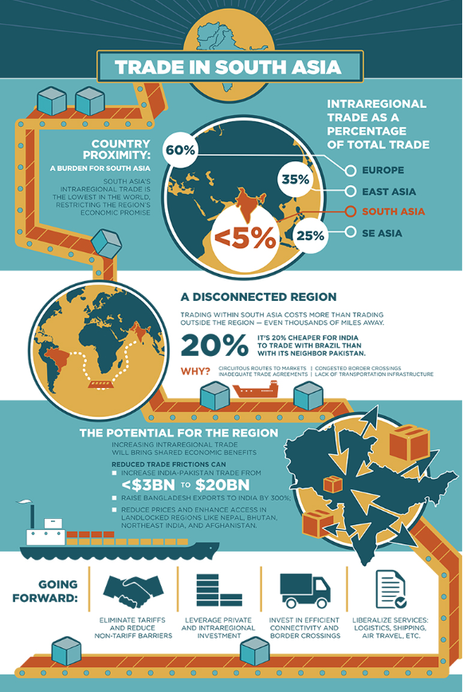
Regional Integration: Trade with mutual benefits
Intraregional trade in South Asia is low.
Intraregional trade accounted for <5% of South Asia's total trade, compared to 25% in SE Asia and 35% in East Asia region.
Challenges that need to be addressed: (1) High trade barriers; (2) Poor infrastructure; (3) Political tensions
Efforts/Initiatives:
In 2006, the South Asian Association for Regional Cooperation (SAARC) launched the South Asia Free Trade Agreement (SAFTA).
SAFTA has reduced tariffs on many goods but has not been as successful as hoped in increasing intraregional trade.
The South Asia Sub-regional Economic Cooperation (SASEC) is a regional initiative to promote trade and economic cooperation between South Asian countries.
Regional integration in South Asia has the potential to boost economic growth and reduce poverty.
Infographic Source: https://www.worldbank.org/en/news/infographic/2016/05/24/the-potential-of-intra-regional-trade-for-south-asia

Slide 5
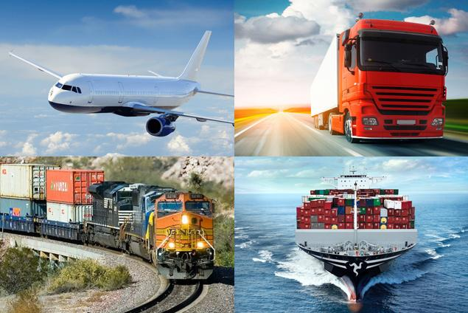
Regional Integration: Transport with mutual benefits
Regional transport connectivity in South Asia is poor.
Challenges that need to be addressed: (1) Political tensions; (2) Financing; (3) Technical expertise
Efforts/Initiatives:
The Bangladesh-India-Myanmar-Sri Lanka-Thailand Economic Corridor (BIMSTEC) Motor Vehicle Agreement, which was signed in 2015, is a regional initiative to improve transport connectivity between the five countries. The EC includes plans to develop road, rail, and air links, as well as to improve port facilities.
The Trans-Asian Railway (TAR) is a long-term project to create a network of railways that will connect Asia from East to West. The TAR includes plans to improve railway links between South Asian countries.
The South Asia Sub-regional Economic Cooperation (SASEC) includes plans to improve transport connectivity between the countries.
Regional integration in South Asia has the potential to boost economic growth and reduce poverty.

Slide 6
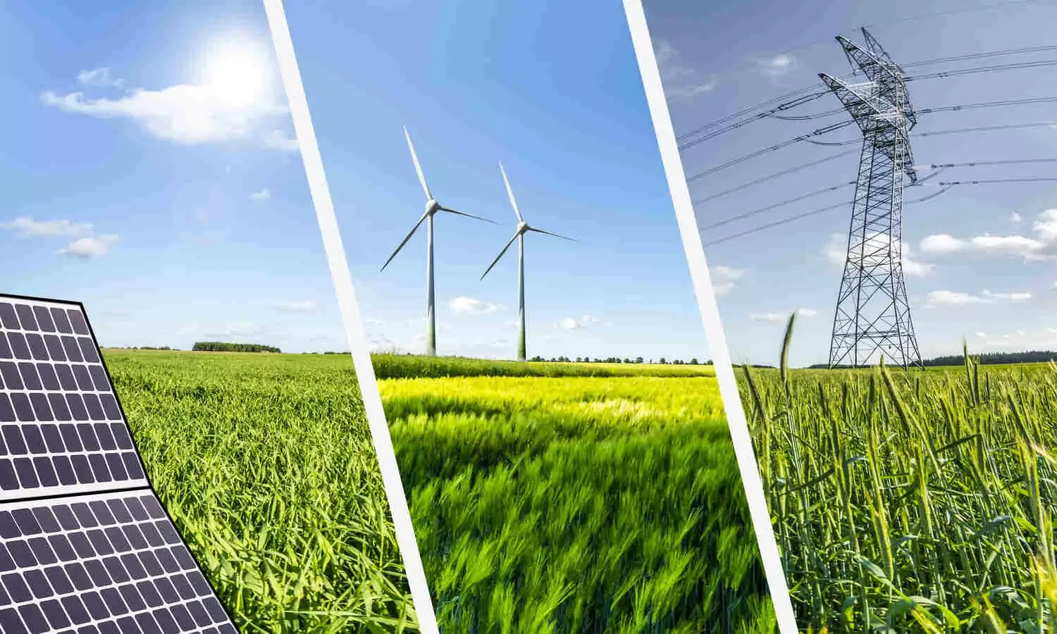
Regional Integration: Energy with mutual benefits
South Asia has a diverse energy mix. The region has a mix of fossil fuels, such as coal and natural gas, as well as renewable energy sources, such as hydropower and solar power.
There is a growing demand for energy in South Asia. The region's population is growing rapidly, and the economy is expanding.
Challenges that need to be addressed: (1) Political tensions; (2) Financing; (3) Technical expertise
Efforts/Initiatives: The South Asian Association for Regional Cooperation (SAARC) has launched a number of initiatives, including:
The South Asia Regional Initiative for Energy Integration (SARI/EI)
The South Asia Energy Forum (SAEF)
The South Asia Power Pool (SAPP)
Regional integration in the energy sector has the potential to bring many benefits to the region. By cooperating, South Asian countries can:
Reduce their energy insecurity
Improve energy access
Reduce greenhouse gas emissions.

Slide 7
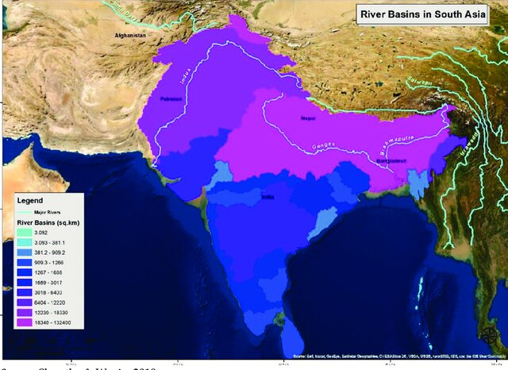
Regional Integration: Water with mutual benefits
South Asia is a water-stressed region.
There are a number of transboundary rivers in South Asia.
Challenges that need to be addressed: (1) Political tensions; (2) Financing; (3) Technical expertise
Efforts/Initiatives:
SAARC has launched the South Asia Water Initiative (SAW) to promote regional cooperation in the areas of water resources management, water security, and climate change adaptation.
The Indus Water Treaty: This treaty was signed in 1960 between India and Pakistan, and it governs the use of the Indus River and its tributaries.
The Ganges Water Sharing Treaty: This treaty was signed in 1996 between India and Bangladesh, and it governs the use of the Ganges River.
The countries in South Asia can cooperate on water management in a number of ways, such as:
Sharing water data and information
Developing joint water management plans
Building regional water infrastructure

Slide 8
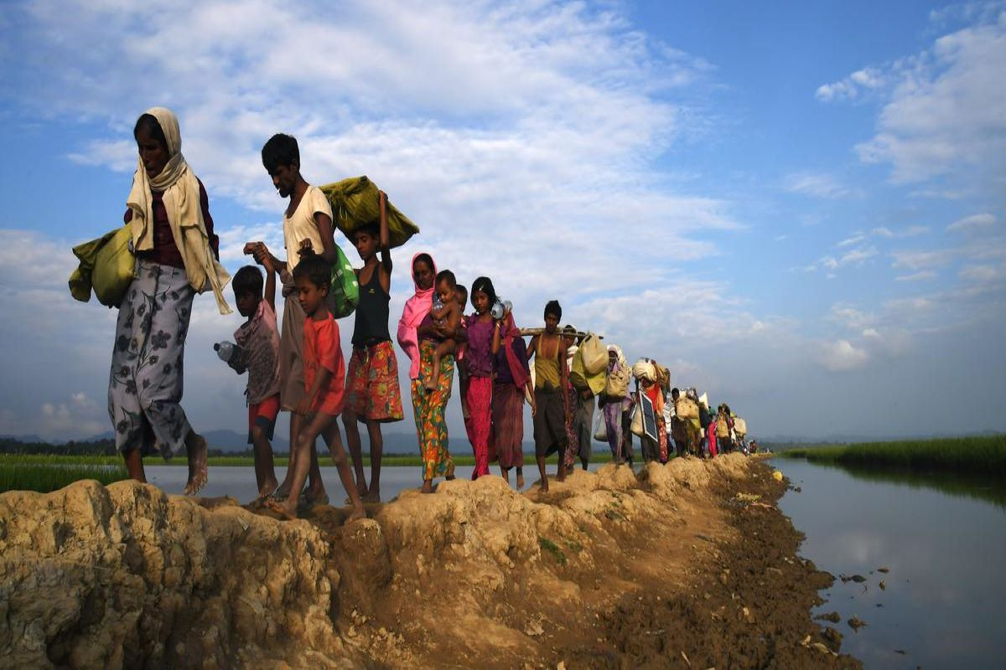
Regional Integration: Migration
South Asia is a region of high migration.
The region has a long history of migration, and it is estimated that there are over 200 million migrants living in South Asia.
This is due to a number of factors, including:
Poverty: in search of better economic opportunities.
Conflict: to escape violence and persecution.
Natural disasters: to escape these disasters.
Challenges that need to be addressed: (1) Political tensions; (2) Security concerns; (3) Economic impact; (4) Common migration policy/cooperation between countries
Efforts/Initiatives:
SAARC Convention on the Movement of Persons.
The International Labour Organization (ILO) has also been active in the region, and it has developed a number of tools and resources to help countries manage migration.
A number of countries in the region have also developed their own national policies on migration. For example, India has the "National Migration Policy" and Bangladesh has the "National Migration Management Plan."

Slide 9
Can AAEA Meeting Contribute?
In-depth Analysis
Advancement of Trade
Development
Integrated agenda

Slide 10
Thank you for your time and attention 🙂

